Slide 1
Working with the IRIS DMC: Submitting Data
TIM AHERN, DIRECTOR, IRIS DATA SERVICES
Training in Network Management Systems and Analytical Tools for Seismology • 23–27 October 2017 • Baku, Azerbaijan

Slide 2
Submitting data to IRIS
Real time using SeedLink protocol
Included with SeisComp3
Delayed transfer using IRIS ring buffer
miniseed2dmc
https://github.com/iris-edu/miniseed2dmc
Both ends of the connection have to enable firewalls
More methods
Training in Network Management Systems and Analytical Tools for Seismology • 23–27 October 2017 • Baku, Azerbaijan

Slide 3
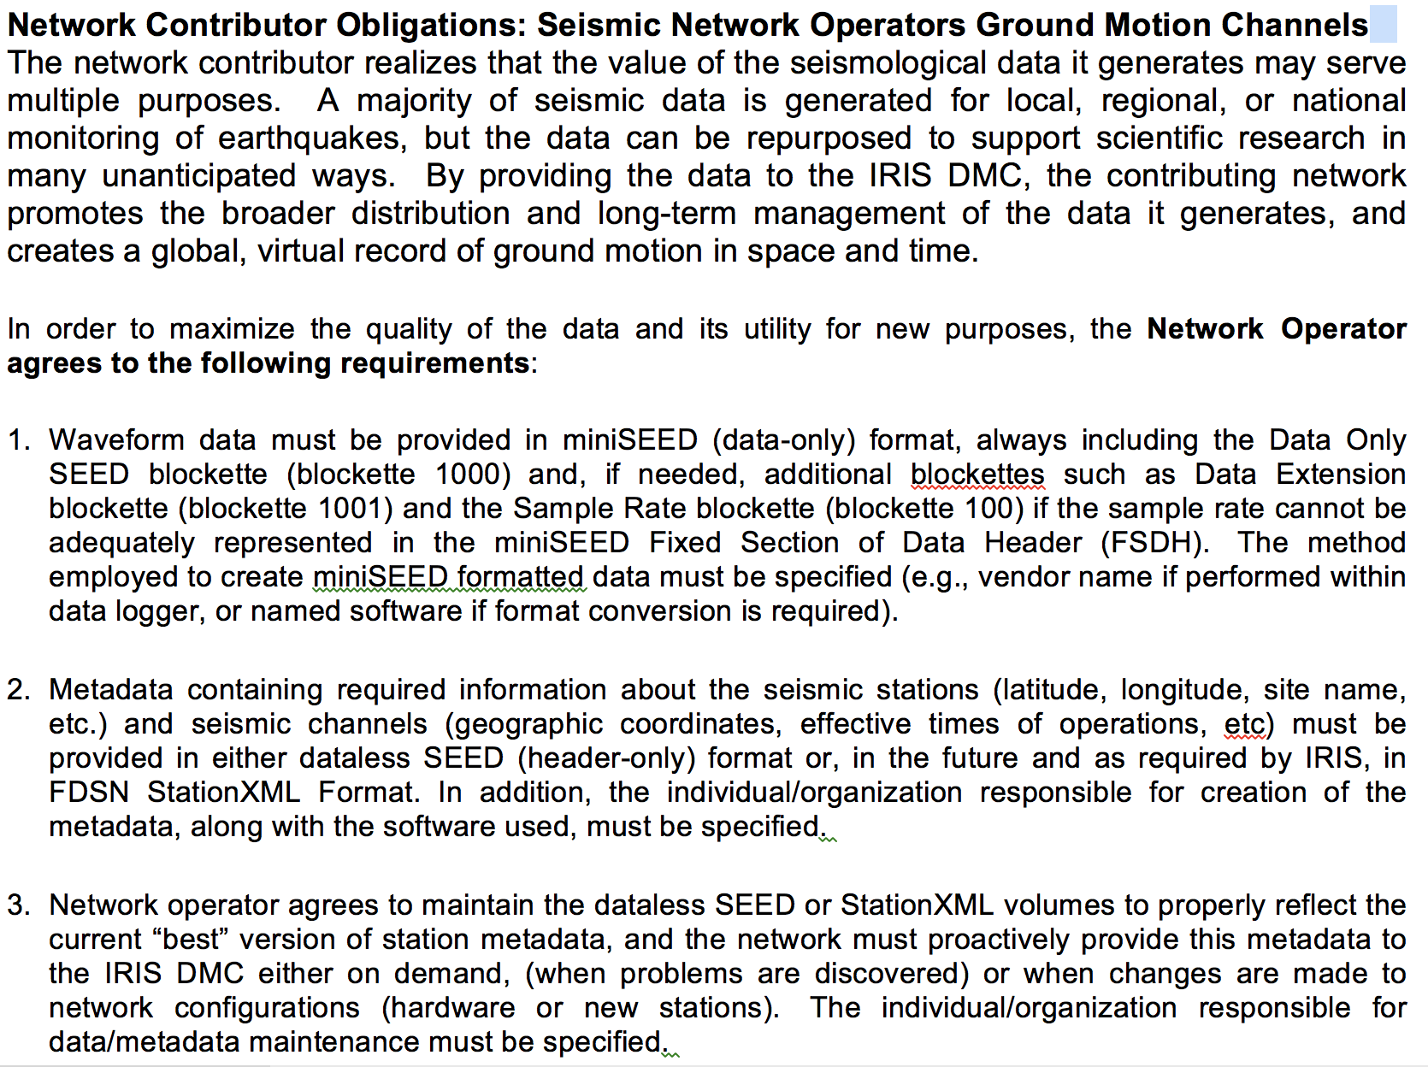
Data Provider Agreements Network Provider obligations
miniSeed
metadata
maintain

Slide 4
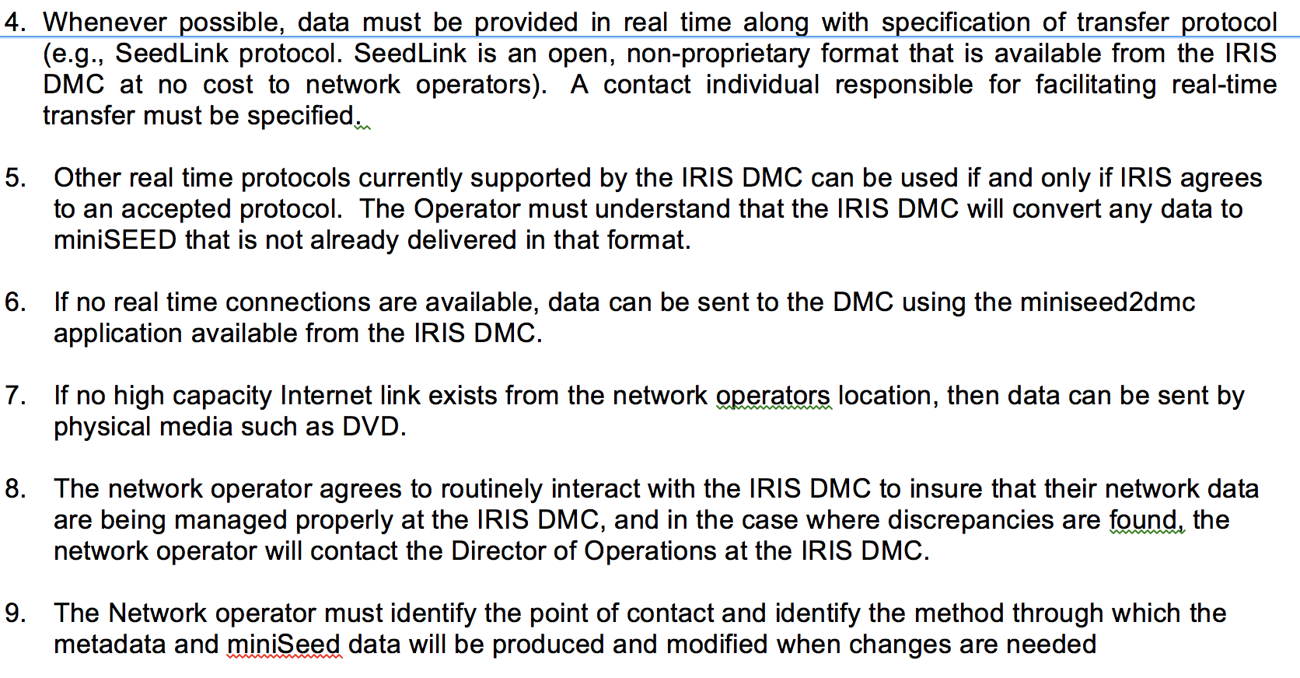
DPA Network Obligations
Real time-seedlink
Other real time
mseed2dmc
media
involvement
Point of contact
Training in Network Management Systems and Analytical Tools for Seismology • 23–27 October 2017 • Baku, Azerbaijan

Slide 5
DPA Non-Seismic Provider Obligations
Training in Network Management Systems and Analytical Tools for Seismology • 23–27 October 2017 • Baku, Azerbaijan

Slide 6
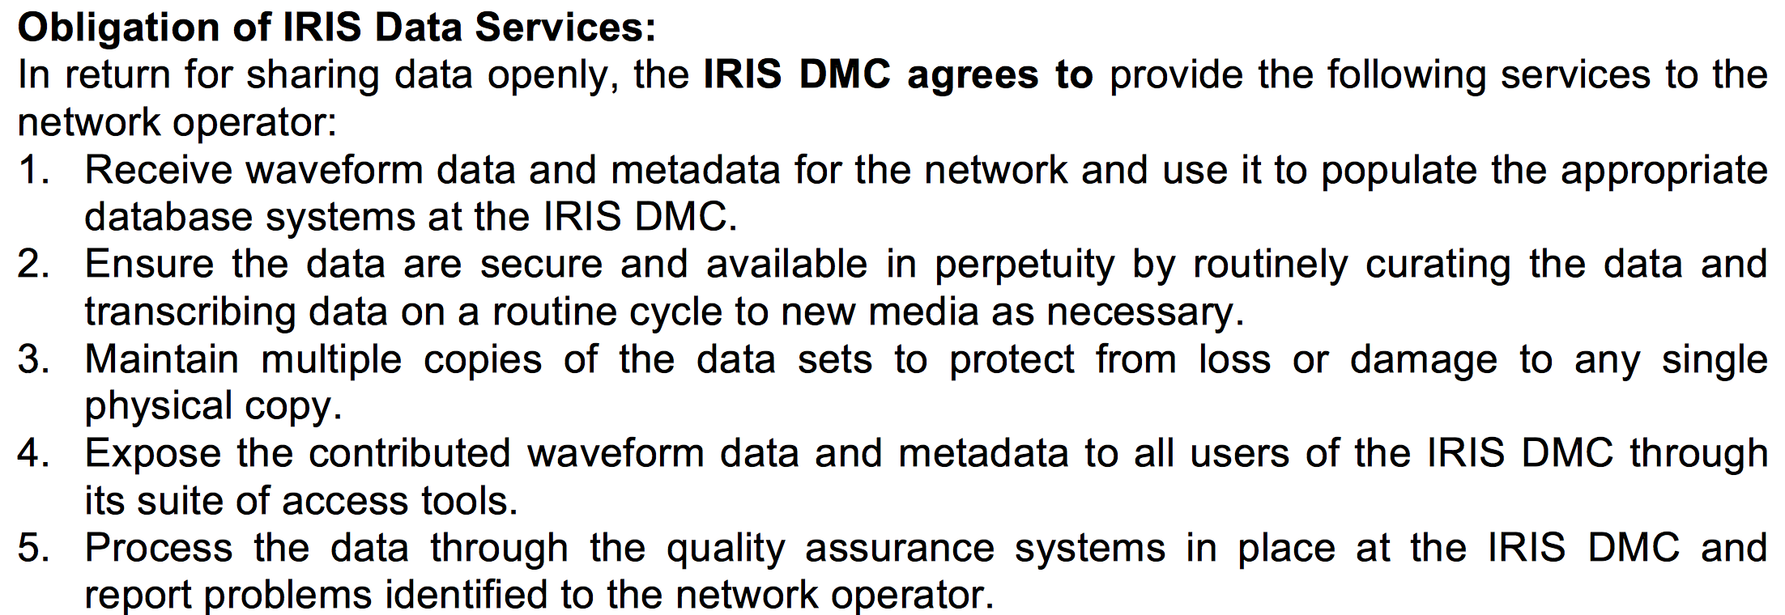
DPA IRIS Obligations
Quality control
Monthly Reports
Training in Network Management Systems and Analytical Tools for Seismology • 23–27 October 2017 • Baku, Azerbaijan

Slide 7
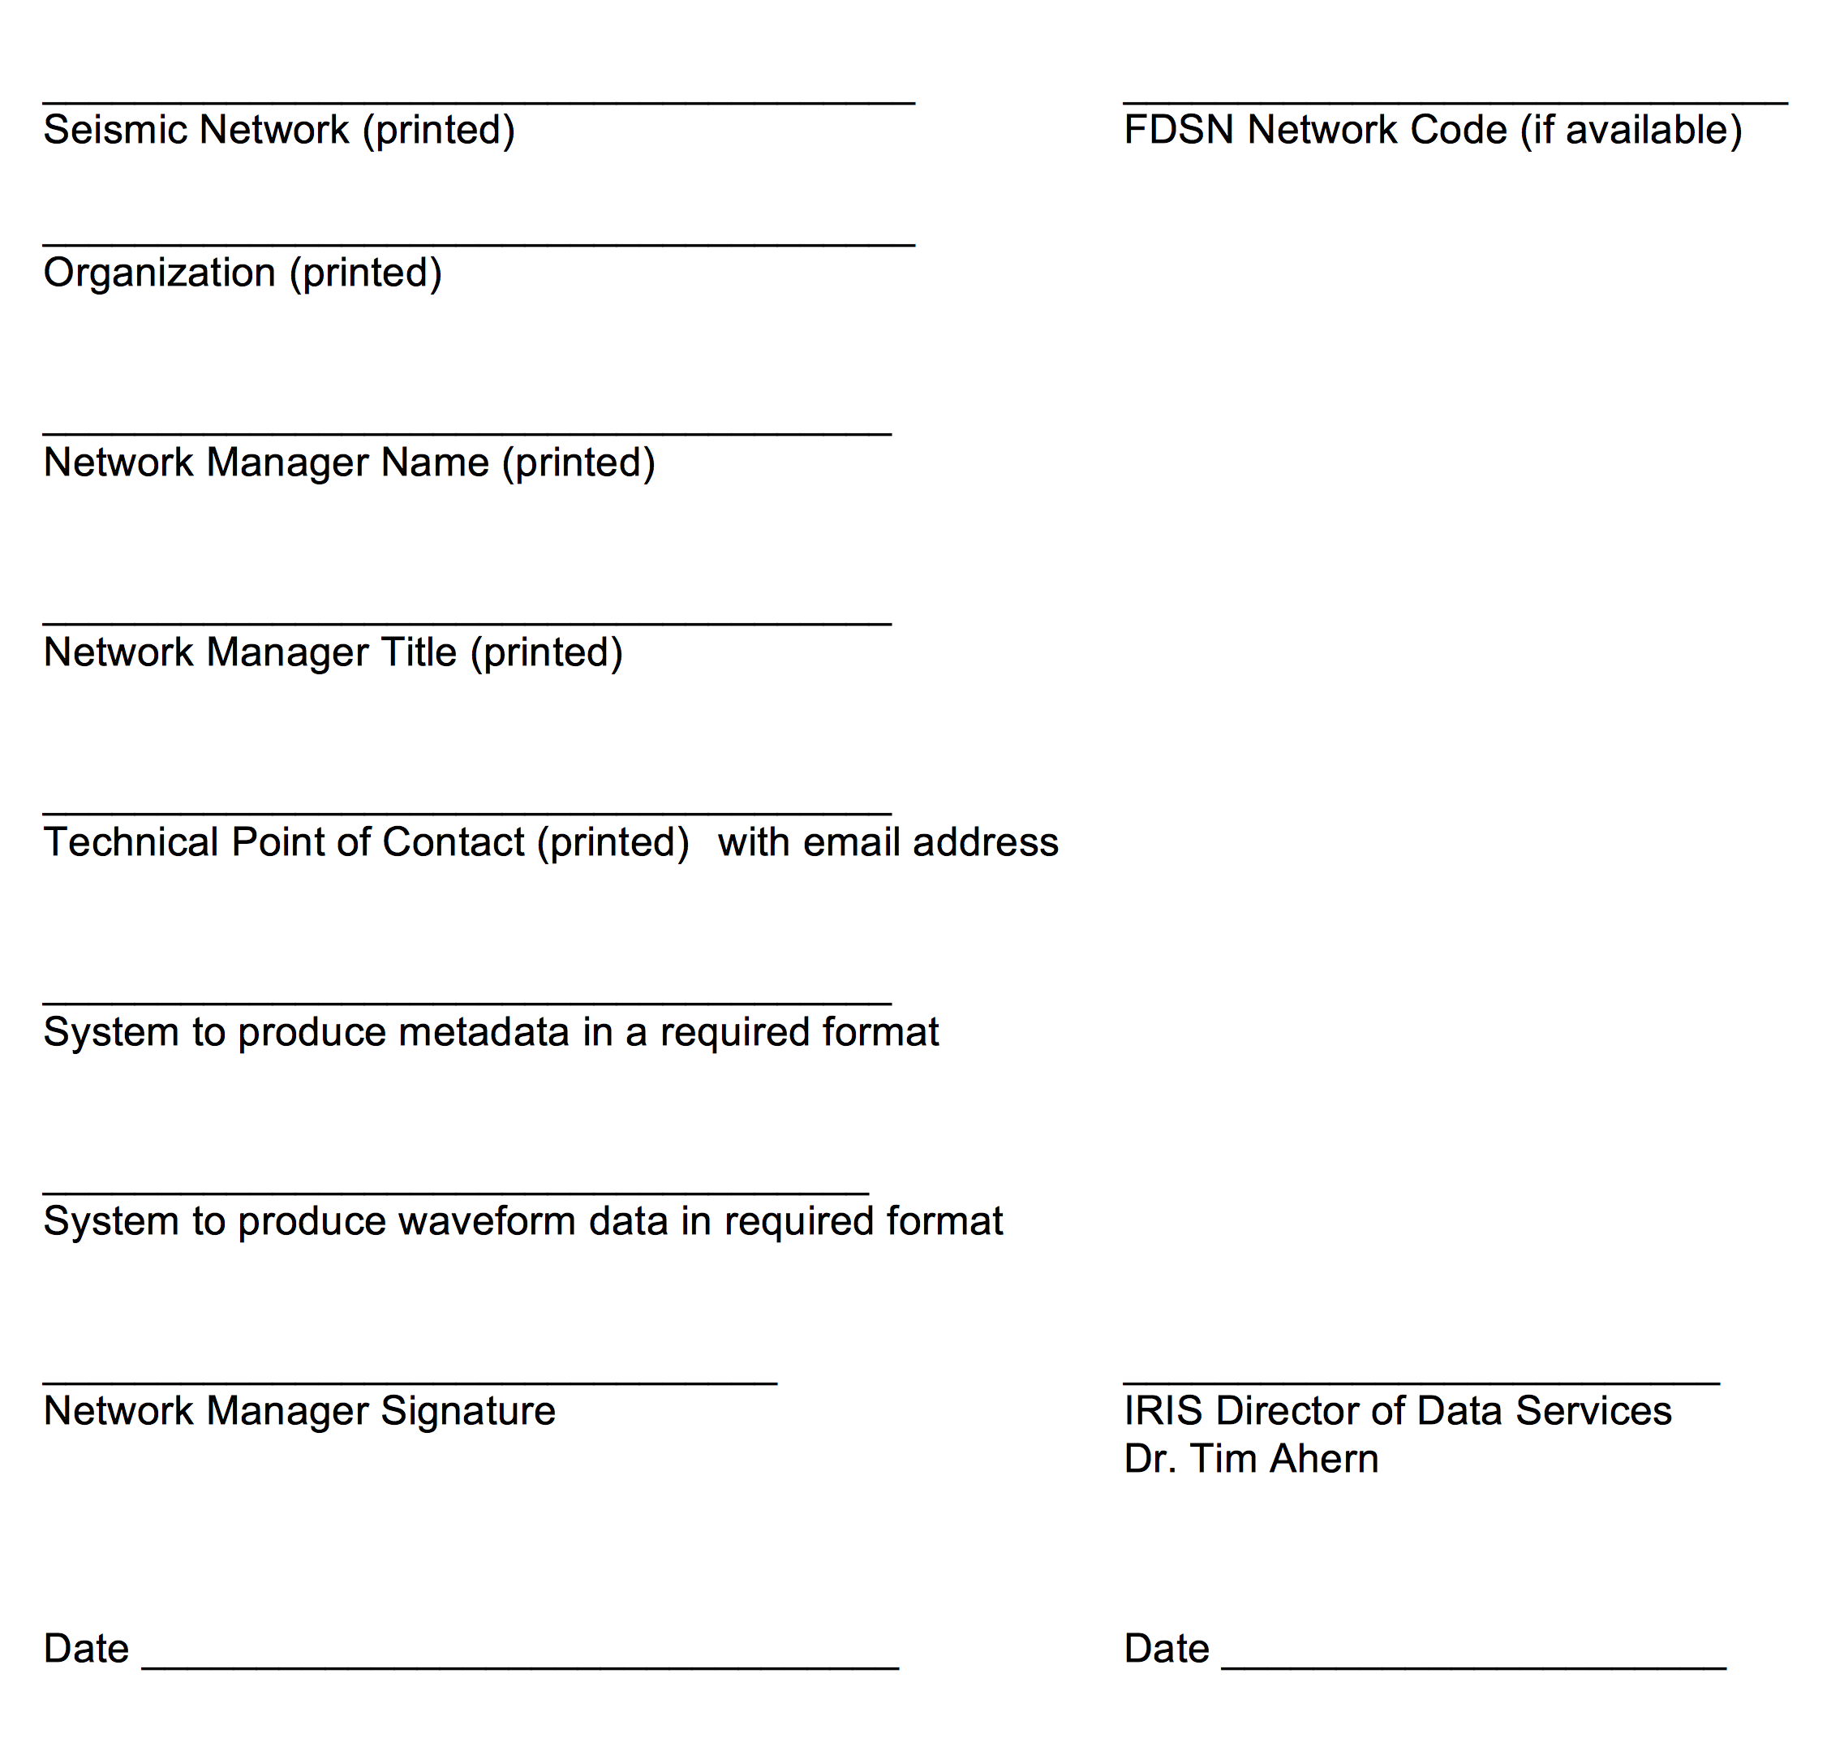
DPA – Keep the contact information up to date!!!
Training in Network Management Systems and Analytical Tools for Seismology • 23–27 October 2017 • Baku, Azerbaijan

Slide 8
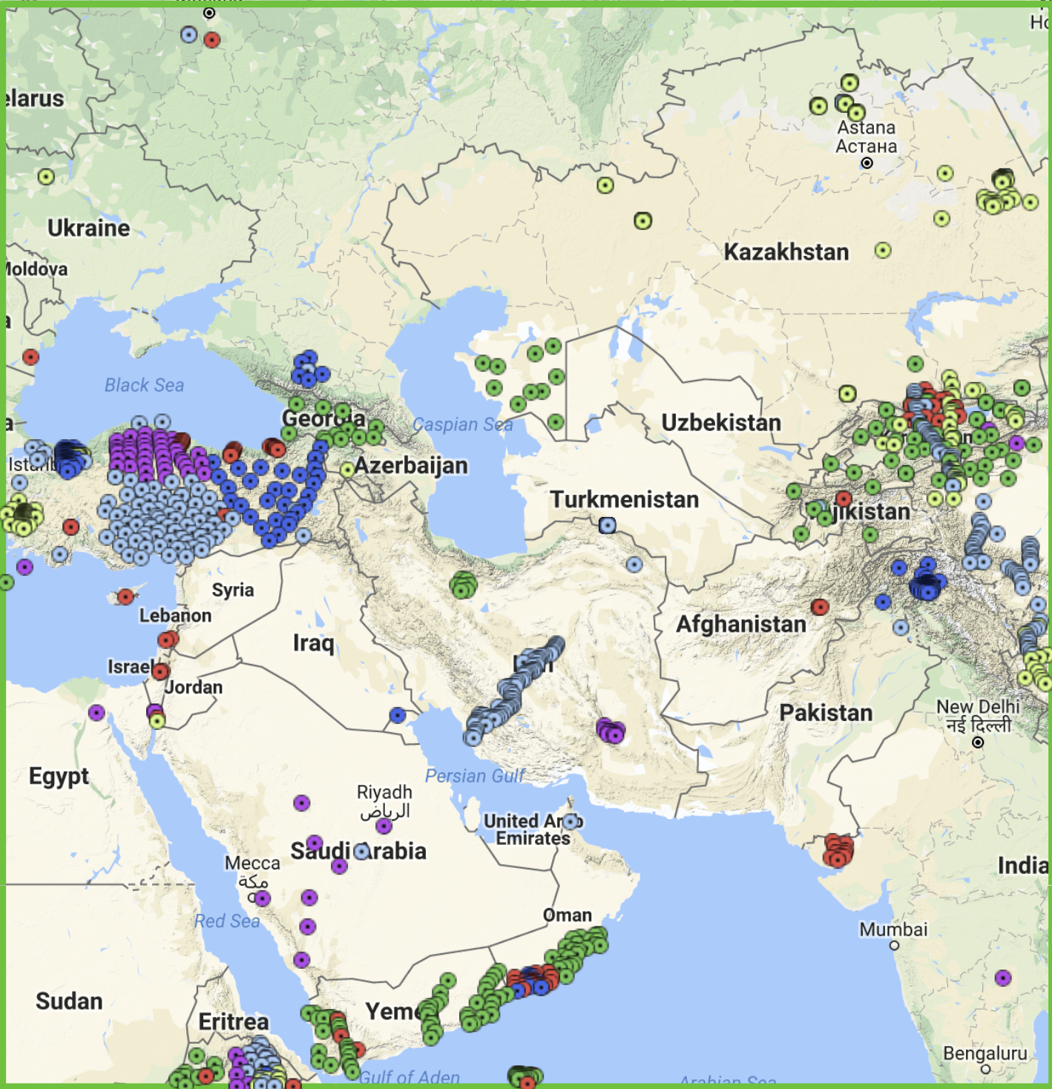
Thanks to our data contributors 1127 stations
We hope others will also share
data within the FDSN framework
Training in Network Management Systems and Analytical Tools for Seismology • 23–27 October 2017 • Baku, Azerbaijan

